Slide 1


Yup, doing so will simplify the algorithms
We have hidden the bias term inside the model as its last coordinate $\left[w,b\right]$ and appended a 1 at the end of the features $\left[x,1\right]$. Note that ${\left[w,b\right]}^{⊤}\left[x,1\right]=w^{⊤}x+b$
$$\min_{w∈ℝ^{d}}{{\frac{1}{2}\left\|w\right\|}_{2}^{2}+C\sum_{i=1}^{n}{{\left[1−y^{i}⋅w^{⊤}x^{i}\right]}_{+}}}$$

Slide 2
my first solver
A journey of a thousand miles begins with a single step
– Dàodé Jīng (Chap. 64), Laozi, ~400BC

Slide 3


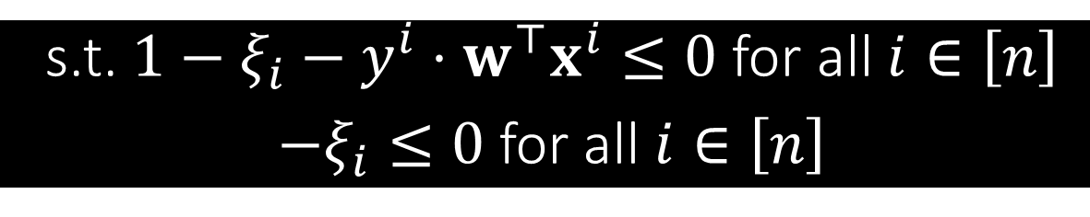
C-Support Vector Machine
As per our convention, we rewrite $≥$ constraints as $≤$ constraints
$$\min_{w∈ℝ^{d}}{{\frac{1}{2}\left\|w\right\|}_{2}^{2}+C\sum_{i=1}^{n}{{\left[1−y^{i}⋅w^{⊤}x^{i}\right]}_{+}}}$$
$n$ points and $d$-dim feature vectors, $w,x^{i}∈ℝ^{d},y^{i}∈\left\{−1,1\right\}$
This problem has no constraints – lets introduce some ☺ $\min_{w∈ℝ^{d}}{\frac{1}{2}{\left\|w\right\|}_{2}^{2}}+C\sum_{i=1}^{n}{ξ_{i}}$
s.t. $y^{i}⋅w^{⊤}x^{i}≥1−ξ_{i}$ for all $i∈\left[n\right]$
$ξ_{i}≥0$ for all $i∈\left[n\right]$
Step 0: Already a minimization problem – nothing to do!
Step 1: Introduce dual variables $α_{i}≥0,i∈\left[n\right]$ and $β_{i}≥0,i∈\left[n\right]$
s.t. $1−ξ_{i}−y^{i}⋅w^{⊤}x^{i}≤0$ for all $i∈\left[n\right]$
$−ξ_{i}≤0$ for all $i∈\left[n\right]$

Slide 4



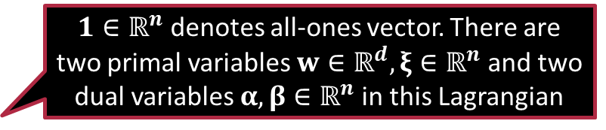
C-Support Vector Machine
Gives us a way to recover the optimal value of $w$ once we have solved the dual problem and obtained the optimal value of $α$
$1∈ℝ^{n}$ denotes all-ones vector. There are two primal variables $w∈ℝ^{d},ξ∈ℝ^{n}$ and two dual variables $α,β∈ℝ^{n}$ in this Lagrangian
$$\min_{w∈ℝ^{d}}{{\frac{1}{2}\left\|w\right\|}_{2}^{2}+C\sum_{i=1}^{n}{{\left[1−y^{i}⋅w^{⊤}x^{i}\right]}_{+}}}$$
Step 2: Create the Lagrangian $ℒ\left(w,ξ,α,β\right)=$ $\frac{1}{2}{\left\|w\right\|}_{2}^{2}−\sum_{i=1}^{n}{α_{i}y^{i}⋅w^{⊤}x^{i}}+ξ^{⊤}\left(C⋅1−α−β\right)+α^{⊤}1$
Step 5: Simplify the dual $q\left(α,β\right)=\min_{w,ξ}{ℒ\left(w,ξ,α,β\right)}$
To minimize w.r.t $w$, apply FOO to get $\frac{∂ℒ}{∂w}=0⇒w=\sum_{i=1}^{n}{α_{i}y^{i}⋅x^{i}}$
To minimize w.r.t. $ξ$, note that if $C⋅1−α−β≠0$, we get $q\left(α,β\right)=−∞$
Since we wish to maximize $q\left(⋅\right)$, we must have $α+β=C⋅1$ at optimum

Slide 5

C-Support Vector Machine
We will now study several methods to solve this simplified dual including a state-of-the-art technique
$$\min_{w∈ℝ^{d}}{{\frac{1}{2}\left\|w\right\|}_{2}^{2}+C\sum_{i=1}^{n}{{\left[1−y^{i}⋅w^{⊤}x^{i}\right]}_{+}}}$$
Step 5: Simplify the dual continued …
Substituting expression for $w$ and using $ξ^{⊤}\left(C⋅1−α−β\right)=0$ gives us
$$\max_{\begin{aligned}α≥0,β≥0 \\ α+β=C⋅1\end{aligned}}{α^{⊤}1−\frac{1}{2}\sum_{i∈\left[n\right]}{\sum_{j∈\left[n\right]}{α_{i}α_{j}y^{i}y^{j}\left\langle x^{i},x^{j}\right\rangle }}}$$
Eliminate the dual variable by setting $β_{i}=C−α_{i}$. Also eliminate the constraint $β_{i}≥0$ by replacing it with the constraint $C−α_{i}≥0$
$$\min_{0≤α≤C⋅1}{\frac{1}{2}\sum_{i∈\left[n\right]}{\sum_{j∈\left[n\right]}{α_{i}α_{j}y^{i}y^{j}\left\langle x^{i},x^{j}\right\rangle }}−α^{⊤}1}$$
Keep Melbo happy by converting dual to a minimization problem ☺

Slide 6



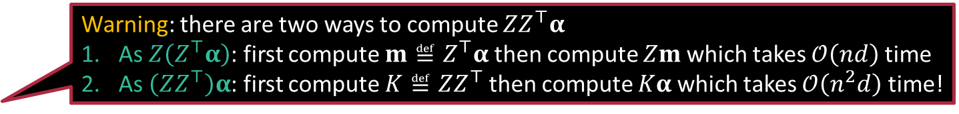

Step 6: Solving the Dual (Proj-GD)
Warning: there are two ways to compute $ZZ^{⊤}α$
As $Z\left(Z^{⊤}α\right)$: first compute $m≝Z^{⊤}α$ then compute $Zm$ which takes $𝒪\left(nd\right)$ time
As $\left(ZZ^{⊤}\right)α$: first compute $K≝ZZ^{⊤}$ then compute $Kα$ which takes $𝒪\left(n^{2}d\right)$ time!
$$\min_{0≤α≤C⋅1}{\frac{1}{2}\sum_{i∈\left[n\right]}{\sum_{j∈\left[n\right]}{α_{i}α_{j}y^{i}y^{j}\left\langle x^{i},x^{j}\right\rangle }}−α^{⊤}1}$$
To make gradient computation simpler, let us simplify the objective
Create $Z∈ℝ^{n×d}$ with $i$-th row as $y^{i}⋅x^{i}∈ℝ^{d}$ and rewrite $\min_{0≤α≤C⋅1}{\frac{1}{2}α^{⊤}ZZ^{⊤}α−α^{⊤}1}$
Derivate of objective w.r.t. $α$ is $g≝ZZ^{⊤}α−1∈ℝ^{n}$
Can be computed in $𝒪\left(nd\right)$ time if we are careful
First get $m≝Z^{⊤}α$ in $𝒪\left(nd\right)$ then $g≝Zm−1$ in $𝒪\left(nd\right)$ time – done ☺
Now perform projected descent step $α^{t+1}←Π_{{\left[0,C\right]}^{n}}\left(α^{t}−η_{t}⋅g^{t}\right)$
Projection step is straightforward as seen in previous discussion
Possible in $𝒪\left(n\right)$ time as we can do it coordinate-wise
I recall even GD in primal took $𝒪\left(nd\right)$ time per iteration. This is too expensive. Something faster please!

Slide 7





Step 6: Solving the Dual (Proj-SGD)
Why the $d$ factor? Why is this a stochastic gradient? Can you give a derivation?
Sure, but for this you will have to wait till we cover prob-stat basics
$$\min_{0≤α≤C⋅1}{\frac{1}{2}\sum_{i∈\left[n\right]}{\sum_{j∈\left[n\right]}{α_{i}α_{j}y^{i}y^{j}\left\langle x^{i},x^{j}\right\rangle }}−α^{⊤}1}$$
We wish to avoid computing the exact gradient $g≝ZZ^{⊤}α−1$
Recall that $Z∈ℝ^{n×d}$ with $d$ columns – why not use a single column?
Choose a random $k∈\left[d\right]$ and let $v∈ℝ^{n}$ be the $k$-th column of $Z$
Compute the stochastic gradient in $𝒪\left(n\right)$ time as $s≝d⋅vv^{⊤}α−1=d⋅\left(v^{⊤}α\right)⋅v−1∈ℝ^{n}$
Perform descent step then projection step in $𝒪\left(n\right)$ time! $α^{t+1}←Π_{{\left[0,C\right]}^{n}}\left(α^{t}−η_{t}⋅s^{t}\right)$
It is very nice that we were able to do the entire Proj-SGD step in $𝒪\left(n\right)$ time. Can we go faster? Say $𝒪\left(d\right)$?

Slide 8







Step 6: Solving the Dual (CM)
Note that ${\left(y^{i}\right)}^{2}=1$ since $y^{i}∈\left\{−1,+1\right\}$
I can apply the QUIN rule to get the optimal value of $α_{i}$ in closed form ☺
$$\min_{0≤α≤C⋅1}{\frac{1}{2}\sum_{i∈\left[n\right]}{\sum_{j∈\left[n\right]}{α_{i}α_{j}y^{i}y^{j}\left\langle x^{i},x^{j}\right\rangle }}−α^{⊤}1}$$
We will solve the dual using coordinate minimization
Recall that CM completely optimizes the objective w.r.t. a chosen coordinate
Choose $i∈\left[n\right]$, find objective terms and constraints depending on $α_{i}$
$$\min_{α_{i}∈\left[0,C\right]}{\frac{1}{2}α_{i}^{2}{\left\|x^{i}\right\|}_{2}^{2}+α_{i}y^{i}\sum_{j≠i}{α_{j}y^{j}\left\langle x^{i},x^{j}\right\rangle }−α_{i}}$$
Rename $u≝{\left\|x^{i}\right\|}_{2}^{2}$ and $v≝y^{i}⋅\sum_{j≠i}{α_{j}y^{j}\left\langle x^{i},x^{j}\right\rangle }$ to get $\min_{α_{i}∈\left[0,C\right]}{\frac{1}{2}uα_{i}^{2}−α_{i}\left(1−v\right)}$
Exactly, but with careful bookkeeping, this can be sped up!
Hold on a second … if we compute $u.v$ from scratch, it will take $𝒪\left(nd\right)$ time – no savings ☹

Slide 9





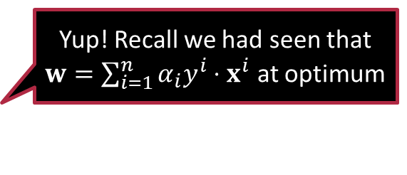

Speeding up CM using Bookkeeping
Yup! Recall we had seen that $w=\sum_{i=1}^{n}{α_{i}y^{i}⋅x^{i}}$ at optimum
If we keep $z$ updated as we update the $α_{i}$ values, then at the end of the day $z$ itself be the optimal model!
Speeding up computation of $u$
Pre-compute $r_{i}≝{\left\|x^{i}\right\|}_{2}^{2}$ for all $i∈\left[n\right]$ and store in some vector $r∈ℝ_{+}^{n}$
Accessing $u$ during a CM step can now be done in $𝒪\left(1\right)$ time ☺
Speeding up computation of $v$
By linearity of the dot product, we get $v≝y^{i}⋅\sum_{j≠i}{α_{j}y^{j}\left\langle x^{i},x^{j}\right\rangle }=y^{i}⋅\left\langle x^{i},\sum_{j≠i}{α_{j}y^{j}⋅x^{j}}\right\rangle$ $=y^{i}⋅\left\langle x^{i},\sum_{j∈\left[n\right]}{α_{j}y^{j}⋅x^{j}}−α_{i}y^{i}⋅x^{i}\right\rangle =y^{i}⋅z^{⊤}x^{i}−α_{i}{\left\|x^{i}\right\|}_{2}^{2}$
Define a bookkeeping variable $z≝\sum_{j∈\left[n\right]}{α_{j}y^{j}⋅x^{j}}∈ℝ^{d}$
Can get $v=$ $y^{i}⋅z^{⊤}x^{i}−α_{i}r_{i}$ in just $𝒪\left(d\right)$ time with bookkeeping ☺
Once we update an $α_{i}$ value, updating $z$ also takes only $𝒪\left(d\right)$ time
With careful bookkeeping, each CM step now takes only $𝒪\left(d\right)$ time instead of $𝒪\left(nd\right)$ time
$$α_{i}r_{i}$$

Slide 10




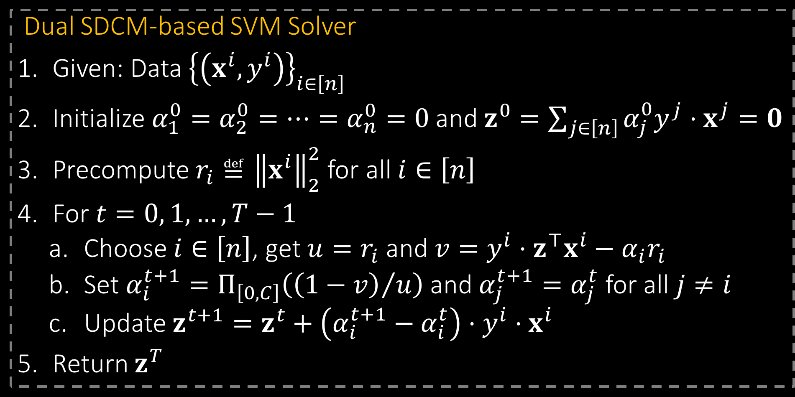

The solver of professionals!
Each iteration takes only $𝒪\left(d\right)$ time! Due its speed, libraries such as sklearn implement SDCM for SVMs
All zeros initialization takes hardly any time!
Dual SDCM-based SVM Solver
Given: Data ${\left\{\left(x^{i},y^{i}\right)\right\}}_{i∈\left[n\right]}$
Initialize $α_{1}^{0}=α_{2}^{0}=…=α_{n}^{0}=0$ and $z^{0}=\sum_{j∈\left[n\right]}{α_{j}^{0}y^{j}⋅x^{j}}=0$
Precompute $r_{i}≝{\left\|x^{i}\right\|}_{2}^{2}$ for all $i∈\left[n\right]$
For $t=0, 1, …,T−1$
Choose $i∈\left[n\right]$, get $u=r_{i}$ and $v=y^{i}⋅z^{⊤}x^{i}−α_{i}r_{i}$
Set $α_{i}^{t+1}=Π_{\left[0,C\right]}\left({\left(1−v\right)}/u\right)$ and $α_{j}^{t+1}=α_{j}^{t}$ for all $j≠i$
Update $z^{t+1}=z^{t}+\left(α_{i}^{t+1}−α_{i}^{t}\right)⋅y^{i}⋅x^{i}$
Return $z^{T}$
Can choose $i$ randomly, cyclically, via random permutation etc.

Slide 11

Exercise
Perform CD on the primal CSVM problem with $w,x^{i}∈ℝ^{d},y^{i}∈ℝ$ $\min_{w∈ℝ^{d}}{\frac{1}{2}{\left\|w\right\|}_{2}^{2}}+C\sum_{i=1}^{n}{{\left[1−y^{i}⋅w^{⊤}x^{i}\right]}_{+}}$
In each iteration, choose a coordinate $w_{j}$ $j∈\left[d\right]$ and update it using a partial (sub) gradient descent step w.r.t. that coordinate i.e., $w_{j}^{t+1}←w_{j}^{t}−η_{t}⋅g_{j}^{t}$ where $g^{t}≝\left[g_{1}^{t},…g_{d}^{t}\right]∈ℝ^{d}$ is a sub-gradient of the objective
Do bookkeeping and precomputations to do a CD step in $𝒪\left(n\right)$ time
Hint: use margins as bookkeeping variables i.e., $s_{i}≝y^{i}⋅w^{⊤}x^{i}$ for $i∈\left[n\right]$

Slide 12





The Big Picture
Remember, we may have to execute several more iterations of SGD/CD/CM than we would have for GD
Algorithm | (P)GD | (P)SGD | CD/CM
Primal $$\min_{w∈ℝ^{d}}{\frac{1}{2}{\left\|w\right\|}_{2}^{2}}+C\sum_{i=1}^{n}{{\left[1−y^{i}⋅w^{⊤}x^{i}\right]}_{+}}$$ | $$𝒪\left(nd\right)$$ straightforward | $$𝒪\left(d\right)$$ straightforward | $$𝒪\left(n\right)$$ as seen in exercise via bookkeeping
Dual $$\min_{0≤α≤C⋅1}{\frac{1}{2}\sum_{i∈\left[n\right]}{\sum_{j∈\left[n\right]}{α_{i}α_{j}y^{i}y^{j}\left\langle x^{i},x^{j}\right\rangle }}−α^{⊤}1}$$ | $$𝒪\left(nd\right)$$ as seen in discussion | $$𝒪\left(n\right)$$ as seen in discussion | $$𝒪\left(d\right)$$ as seen in discussion via bookkeeping
If $d<n$, then primal SGD and dual CM are cheaper per iter
If $n<d$, then dual SGD and primal CD are cheaper per iter
The choice of solver can depend on whether $n>d$ or $d>n$ for our application!

Slide 13

Exercise
Perform CD on the following problem where $w,x^{i}∈ℝ^{d},y^{i}∈ℝ$ $\min_{w∈ℝ^{d}}{\frac{1}{2}{\left\|w\right\|}_{2}^{2}}+\sum_{i=1}^{n}{{\left(y^{i}−w^{⊤}x^{i}\right)}^{2}}$
In each iteration, take a partial gradient descent step w.r.t. $w_{j}$ for $j∈\left[d\right]$
Do bookkeeping and precomputation to do each step in $𝒪\left(n\right)$ time
Hint 1: precompute $u_{j}≝\sum_{i∈\left[n\right]}{{\left(x_{j}^{i}\right)}^{2}}$ for each $j∈\left[d\right]$
Hint 2: use residuals as bookkeeping variables i.e., $r_{i}≝\left(y^{i}−w^{⊤}x^{i}\right)$ for $i∈\left[n\right]$
Can you do CM for the same problem in $𝒪\left(n\right)$ time per step?
In each iteration, completely optimize objective w.r.t. $w_{j}$ for $j∈\left[d\right]$
Hint: Similar bookkeeping strategy as above should work here too!

Slide 14

Summary
Derived the Lagrangian dual for the C-SVM optimization problem
Looked at 3 solvers for the dual problem
Projected gradient descent: $𝒪\left(nd\right)$ time per iteration
Projected stochastic gradient descent : $𝒪\left(n\right)$ time per iteration
Coordinate minimization : $𝒪\left(d\right)$ time per iteration
Learnt the useful techniques of precomputations and bookkeeping
Significantly reduce the iteration complexity of several solvers
Found out that solvers for primal and dual can vary in iteration complexity depending on number of points vs number of dimensions

Slide 15
Stay Curious!
See you next time.

